Slide 1
Meadowbrook
2024
ANNUAL MEETING

Slide 2

A Brief Review of the
Rules & Regulations
https://www.rocktownrealty.com/meadowbrook
The Rules & Regulations
document can be found
on the HOA website
maintained by Rocktown
(along with all meeting minutes)

Slide 3
The majority of the Rules & Regulations document is just a clarification drawn from the Bylaws and Covenants of the HOA.

Slide 4
Homes within Meadowbrook Subdivision are designated for single-family residential purposes exclusively. Short-term rentals, including but not limited to, AirB&B or VRBO listings are strictly prohibited.

Slide 5

Pet Policy:
Dogs, cats, and usual household pets are permitted. However, residents are prohibited from keeping or maintaining unusual numbers of household pets, including for commercial or charitable purposes.
Animals permitted outside a building or other enclosed area must be leashed or otherwise under control at all times.
Residents are required to promptly pick up and dispose of pet waste.

Slide 6

Livestock and Other Animals:
No livestock, poultry, or birds – with the exception of usual household pets – are permitted on any lot.

Slide 7

Signage Limitations:
No sign or advertising exceeding 5 square feet in size are permitted on any lot within the subdivision.

Slide 8
5, 6, 7, 8: Neighborly Behavior
Nuisance Activities Prohibited
Waste Management
Clothesline Restrictions
Satellite Dish Size Limitation

Slide 9

#9
ARC Reviews
Changes or additions to properties must be submitted to the Architectural Review Committee (ARC) for review and approval prior to commencing any work.

Slide 10
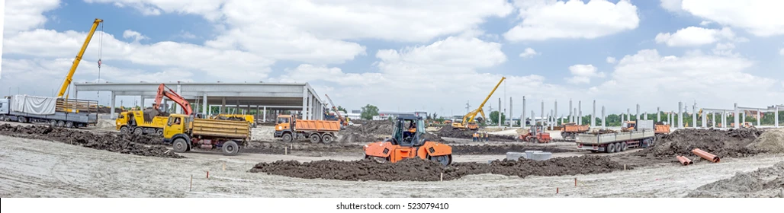
Contractor Regulations

Slide 11
11. Vehicle Restrictions & Requirements
Only automobile, motorcycle, or pickup truck vehicles are allowed on lots. Power boats, mobile homes, commercial buses, trailers, tractors, commercial trucks, or any other motor vehicles are prohibited.
All vehicles must be in working condition with current license, registration, and inspection. Any vehicle lacking a current registration and inspection sticker is not permitted on any lot.
Gas powered recreational vehicles (ATVs, UTVs, Dirt Bikes, Go Karts) are not allowed on common areas or walking trails within the subdivision.

Slide 12
12 & 13
Dues Structure & Penalty for Nonpayment
Dues are assessed quarterly and are payable in advance.
Statements are issued at the beginning of each quarter
Homeowners have the option to pay Quarterly, half in the first quarter and the third quarter, or the full amount upfront.
Failure to remit payment by the end of the first month of each quarter will result in a flat fee of $25.00 assessed on the first day of the following month.

Slide 13
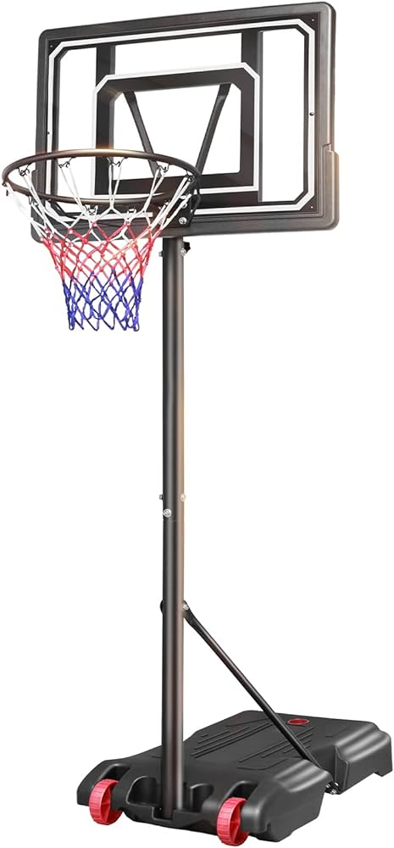
14. Basketball Hoop Restrictions
Permanently installed basketball hoops and similar structures are prohibited within the easement area adjacent to the street.
Portable basketball hoops and similar structures are allowed, provided they are stored away from the street when not in use.

